Slide 1
CE2101 LAB 1
Done by: Kah Hoa, Rui Hong, Yan Qi

Slide 2
TIME COMPLEXITY

Slide 3
Merge Sort, n = 2^{k}
W(1) = 0
W(n) = 2W(n/2) + n - 1
W(2^{k})= 2W(2^{k-1}) + 2^{k} - 1
= 2²W(2^{k-2}) + 2^{k} - 2 + 2^{k} - 1
= 2³W(2^{k-3}) + 3*2^{k} - 2² - 2 - 1
= 2³W(2^{k-3}) + 3*2^{k} - (2² - 2- 1)
= 2^{k}W(2^{k-k}) + k2^{k} - (2^{k} - 1)
= n*w(1) + logn * n - (n-1)
= 0 + nlogn - (n-1)
Notes:
When n = 1, the function will return and thus, W(1) = 0
Merge sort is a divide and conquer algorithm so each time the merge portion will multiply by 2
N - 1 is to account for the key comparison in the worst case

Slide 4
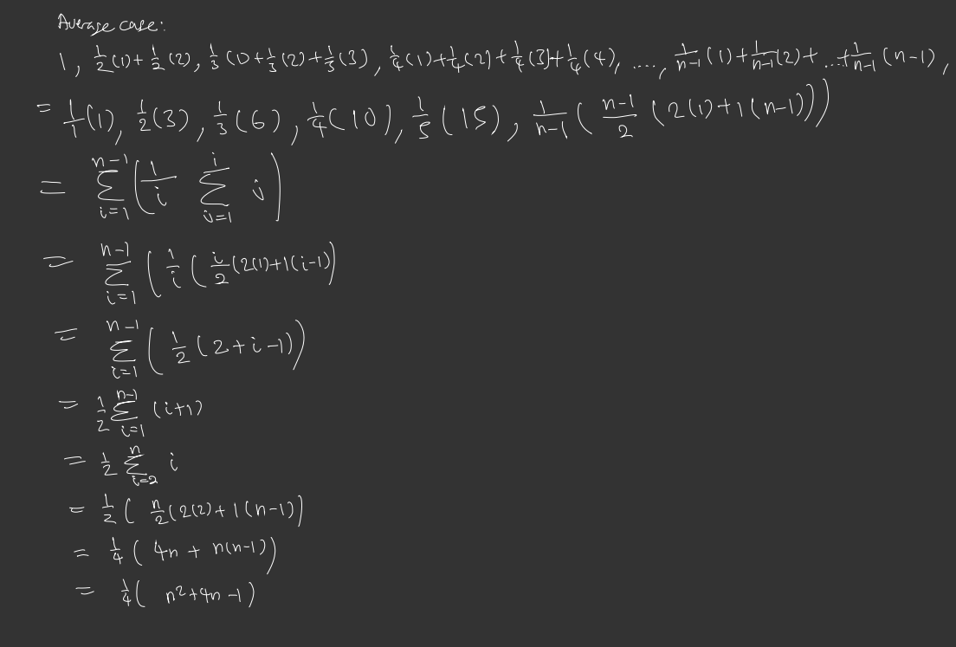
Insertion Sort
Average number of comparisons in ith iteration
Summation for the n-1 iterations
Notes:
Average case of insertion sort: the ith iteration may have 1,2, i key comparisons, each with 1/i chance

Slide 5
Hybrid Sort Time Complexity
Hybrid Sort = Insertion Sort + Merge Sort
For Merge Sort: O(nlogn)
Height of tree: O(logn), n = arrays at the bottom of the tree
Comparisons at each level: O(n), n = all elements in array
Since there are n/S arrays at the bottom, time complexity of merge sort in this hybrid sort is: O(nlogn/S)
Notes:
The time complexity of the hybrid sort will be the sum of the time complexity of the different sorting algorithms
For a normal merge sort, it’s time complexity is O nlogn - where logn is the height of the recursion tree. The n in O(logn) refers to the number of arrays broken down to the smallest sub array.
For The other portion of the merge sort - O(n) represents the Total work done by merge sort in copying n elements from each level to top, and the n here refers to all the elements in total
Since for the hybrid sort there will be n/S arrays at the bottom, where S = threshold integer, the time complexity of the merge sort portion in the hybrid sort is O(nlongn/s)

Slide 6
Hybrid Sort Time Complexity
Since there are n/S arrays to be sorted using Insertion Sort, time complexity of Insertion Sort in this hybrid sort is: O(Insertion) * n/S
Insertion Sort: S = threshold
Worst Case & Average Case: O(S^2)
Best Case: O(S)
Thus, time complexity of hybrid sort:
Worst Case & Average Case: O(nS + nlog(n/S) )
Best Case: O(n + nlog(n/s) )
Notes:
Next we have to insertion sort part of the hybrid sort. Since there are n/S arrays to be sorted using Insertion Sort, time complexity of Insertion Sort in this hybrid sort is O(Insertion) * n/S. According to what we learnt during our lectures, we know that the worst case

Slide 7
OPTIMAL VALUE OF S

Slide 8
Reason why we need an optimal value
Hybrid Sort (Merge - Insertion Sort) make use of Insertion Sort at small values of sub-arrays so that we can reduce the issue of performance overhead of MergeSort alone.
By switching at a suitable S value , we can allow the Hybrid sort to operate optimally.

Slide 9
Using graphical approach
Finding the intersection of the original Merge Sort & original Insertion Sort.
Using average cases for both the sorting algorithm
Average Time Complexity of Merge Sort : n log n
Average Time Complexity of Insertion Sort : ¼(n^2 + n - 2)

Slide 10
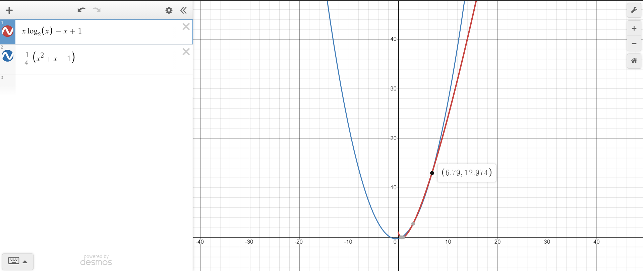

Slide 11
Testing hybrid algorithm with different input sizes
We ran the algorithm with varying S values on different input sizes (10000 , 50000 , 100000) and consolidated the results
S values tested are {1,2,4,8,16,32,64}.

Slide 12
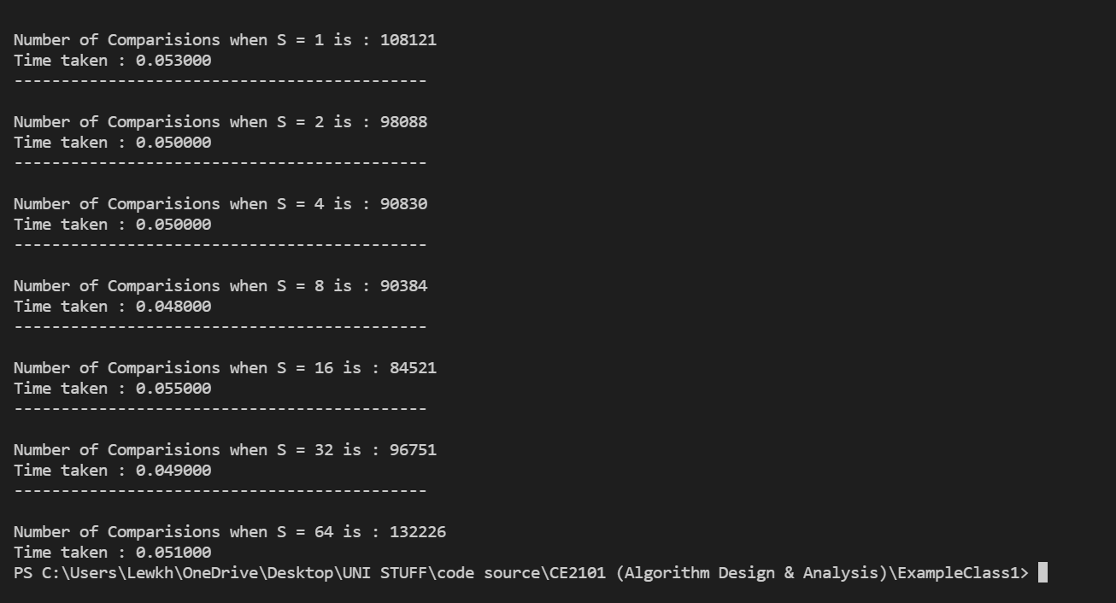
Input Size = 10000

Slide 13
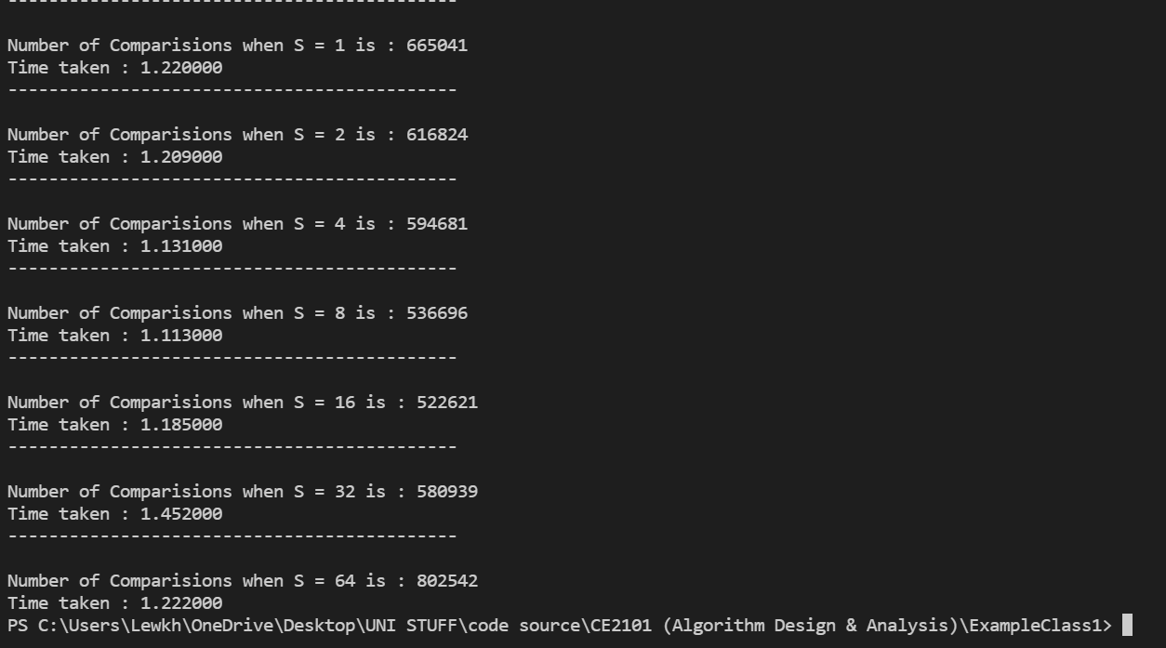
Input Size = 50000

Slide 14
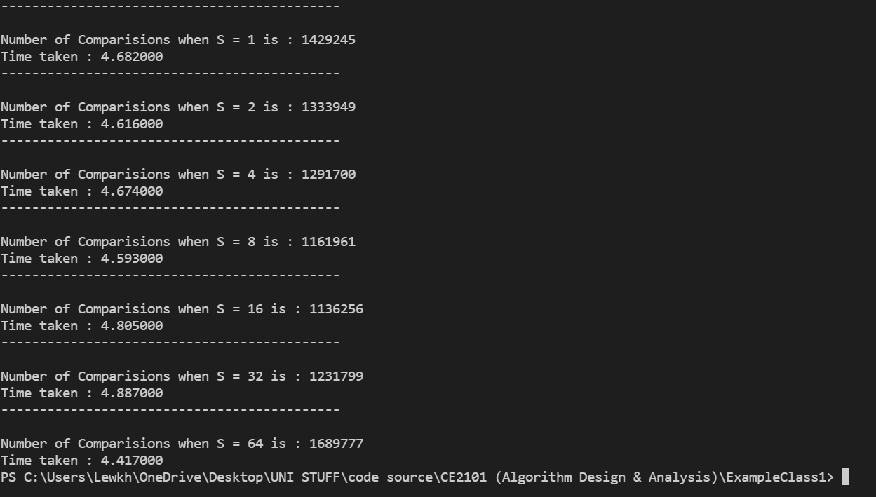
Input Size = 100000

Slide 15
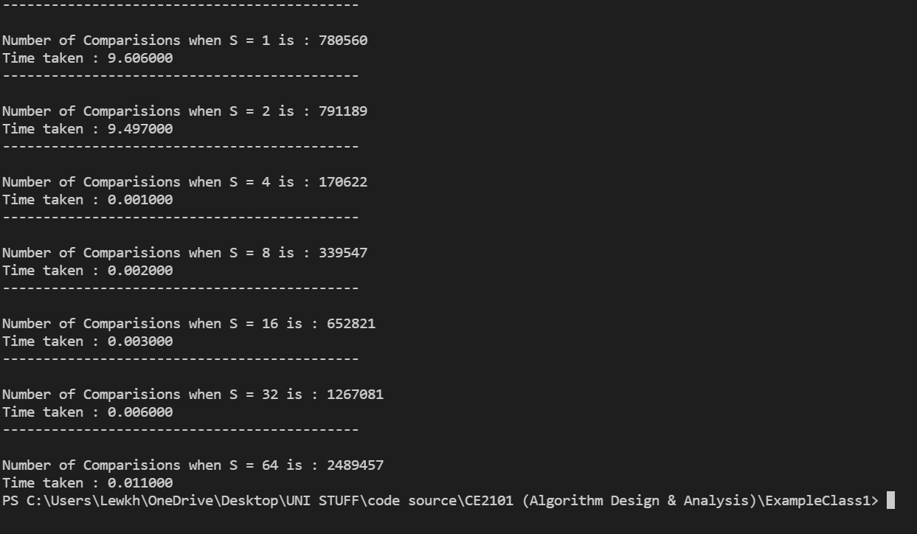
Input Size = 100000 with reversely sorted array

Slide 16
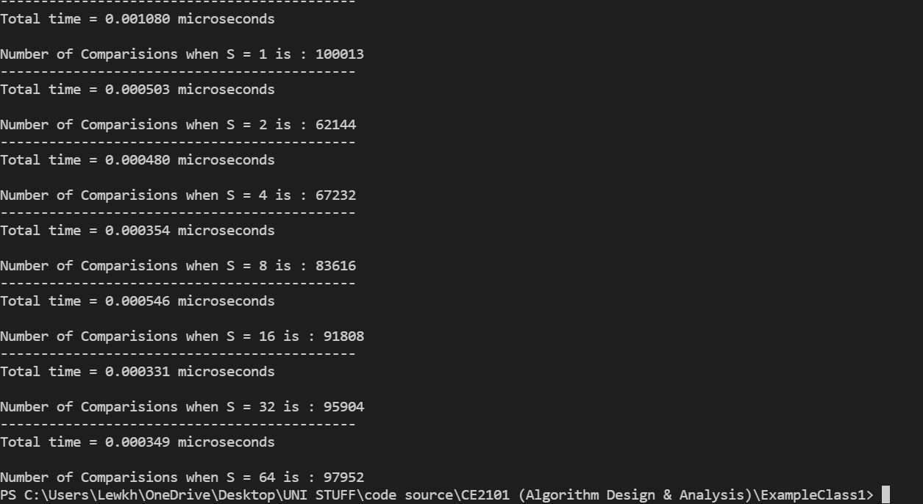
Input Size = 100000 with sorted array

Slide 17
Conclusion
From the different input sizes and cases, we see that the optimal S value for the fastest execution time changes also
We decide to choose our S value to be = 8 in the end.

Slide 18
ORIGINAL MERGESORT

Slide 19
Performance of Merge Sort
As the problem increases in size, the number of recursive calls in merge sort increases exponentially as the depth of the recursion increases.
Taking an array size of 32 as an example:
Array size of 32 is initially divided into 2 arrays of size 16 -> 2 recursive calls.
The 2 arrays of size 16 are further divided into 4 arrays of size 8 -> 4 recursive calls.
The 4 arrays of size 8 are further divided into 8 arrays of size 4 -> 8 recursive calls.
The 8 arrays of size 4 are further divided into 16 arrays of size 2 -> 16 recursive calls.
The 16 arrays of size 2 are further divided into 32 arrays of size 1 -> 32 recursive calls.
It is clear that there is an exponentially increase in recursive calls as the depth of recursion increases.

Slide 20






Merge sort vs Hybrid sort
For input array size = 10000, 50000, 100000 and sorted in random order
Merge sort
Hybrid sort

Slide 21
Conclusion
Hybrid Sort does not improve performance by reducing the number of comparisons
Hybrid performance is improved from the reduction of actual execution of its algorithm

